Slide 1
AI Cyber Risks Everyone Should Watch Out For: BCH Power Pioneers

Slide 2
Intro
    Who am I?
Thelma Muronzi, Cybersecurity Awareness Program Advisor/Project Manager
Cybersecurity Consultant: KPMG Canada
Senior Security Researcher: Digital Information Security Solutions (DIGISS LLC), US
IT Security Specialist: Pharmerit International now Open Health, US
    Training & Education:
      Master of Business Administration, CA
      Master of Science in Applied Information Technology, US
      Post Baccalaureate Certificate in Information Security and Assurance, US
      Bachelor of Commerce in Informatics, SA
      CompTIA Security + Certification
      ICMCP-Google Red Team Hacking Certification

Slide 3
BCH Pioneers Cybersecurity
Eric Rivera – BBIT/Change Management Advisor

Slide 4
How many of us have been victims of a scam?

Slide 5
What population do you think is more susceptible to being scammed?

Slide 6
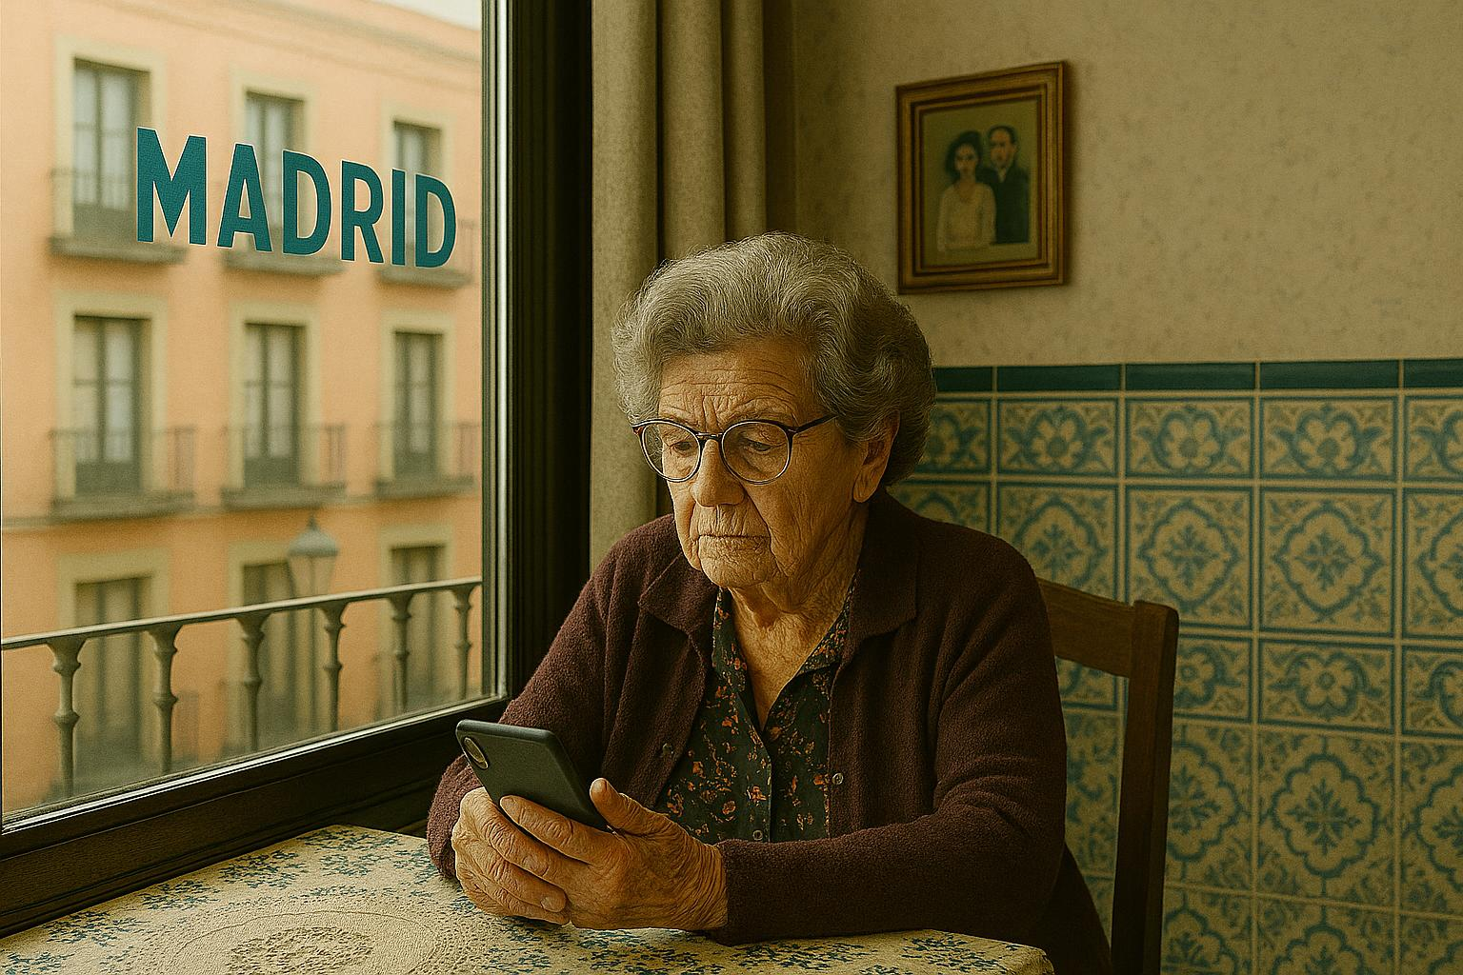

Grandma’s Story
Notes:
So one day, my grandma received a call from her Bank, Santander, letting her know there was suspicious activity and a high chance her account was compromised.
To verify her identity, the agent asked for personal information, including her full name, date of birth, account number, home address, phone number and current password.
My grandma, without any doubt, shared all of these details without suspecting anything.
Finally, the agent asked my grandma if she would receive a text message with a number, so the agent could check their account.
My grandma kindly shared those numbers, which were the verification code.
The agent kindly said, Maria Gomez, I've checked and everything looks normal.
2 days later, my mom is in charge to help her to pay bills and she noticied that her account is in 0.
My mom called my grandma to find out what's going?
Poor grandma, she said, " Oh yeah on Tuesday the bank called me that it was a suspicious activity and there isn't anything to be worried.
Grandma said, "why"
My mom, what kind of questions did the bank ask you? They just asked for details.
Immediately, my mom knew she had been a victim of a scam, and she lost around 4,000 euros.
My mom didn't hear right away about the whole thing because she gets nervous, which causes anxiety for her.
So my mom called her brothers, and together they put money back, not the whole amount, but some, so Grand she doesn't suspect.
Anyway, somehow grandma knew that she was a victim.
We reported this with POLICIA. We shared the phone number and the ID caller, but unfortunately, the Police said that this type of scam is very common to happen to senior people, and they know what population to target, and they have an extensive database of senior people.
So this happened recently, and honestly… we're all still a bit shaken by it.
A couple of days ago, my grandma got a call from someone claiming to be from her bank, Santander. The caller said there was “suspicious activity” on her account and that her money might be at risk. Of course, that got her attention immediately.
To “verify her identity,” the so‑called agent asked for all her personal information — full name, date of birth, account number, home address, phone number, AND her password.
And my sweet grandma… absolutely trusting… gave them everything without a second thought.
Then the caller said she would receive a text message with a code, and that reading the code aloud would “help them check her account.”
Yeah… that was the verification code that let them into her online banking.
Grandma read it out, the scammer said:
“Everything looks normal, Maria Gomez. You don’t have anything to worry about.”
And that was it.
Fast‑forward two days.
My mom — who helps Grandma with bills — logs into her account and sees €0.00. Completely wiped.
She calls my grandma right away, trying to figure out what happened.
Grandma casually says, “Oh yes, the bank called me on Tuesday. They told me there was suspicious activity but everything was fine.”
My mom: “What kind of questions did they ask you?”
Grandma: “Just normal things… details.”
And that’s when my mom instantly knew. She didn’t tell Grandma right away because she knew it would cause her a lot of panic and anxiety. Instead, she called her siblings, and they all chipped in some money — not the full amount, but enough so Grandma wouldn’t notice the account was empty.
But somehow… Grandma eventually put the pieces together. And when she realized she had been scammed, she was heartbroken.
We reported everything to the police — the number, the caller ID, the details — but what they told us was honestly depressing. They said scams like this are extremely common, especially targeting seniors. These scammers have huge databases of older people and know exactly how to manipulate them.
So yeah… that’s how my grandma lost around €4,000 to a scammer pretending to be from her own bank.
Please check on your elderly family members. Remind them: banks will NEVER ask for passwords or verification codes. Ever.
This could have happened to anyone’s grandma.

Slide 7

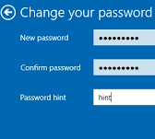

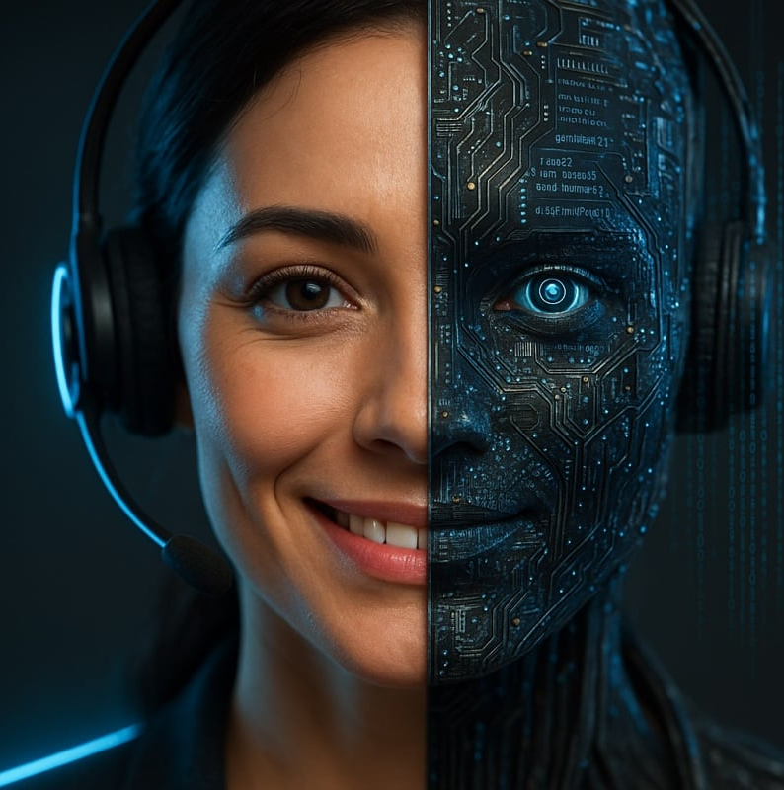


What should Grandma do immediately?
Change her online banking password
Be Aware of AI agents’ calls
Make it something new and strong.
If she reuses that password anywhere else, change it there too.
Don't answer a phone call unless you know the caller
Set up her voicemail
Don’t answer calls and let them record a voicemail
Turn on the “Call blocking option.”
Contact her bank directly
Phone calls / Voicemail configuration
Report this to the bank
Ask them to check for unauthorized activity
Enable 2-factor authentication (2FA)
Enable Bank Alerts
  Login Alerts
  Transaction alerts
  Ask if these notifications can be shared with someone else
Teach the “Pause Before You Act” Habit
Scammers create urgency:
“Your account is at risk!”
“You will lose your money!”
“Act NOW!”
Have her take 10 seconds before responding and tell someone.
Some Habits and Rules
Yellow pages / Social media
Set Up a Trusted Contact
Tell her:
“If anything feels suspicious, call me before doing anything.”
Put your number on a sticky note near her phone.
Remove Her Number From Public Listings
Including:
Yellow pages book
Social media

Slide 8

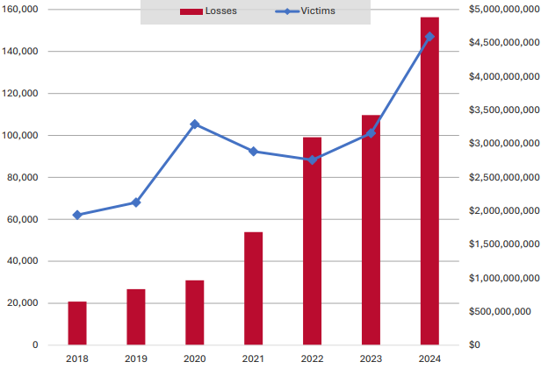
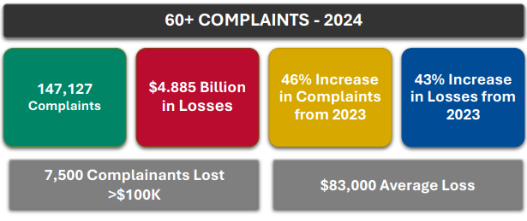
Did you Know?
FBI Elder Report 2024
Sources: https://www.ic3.gov/AnnualReport/Reports/2024_IC3Report.pdf

Slide 9
Did you Know?
    According to FBI, cybercriminals are increasingly using AI tools like voice cloning and deepfake impersonation
    The Canadian Anti-Fraud Centre noted that seniors are increasingly targeted, with reported losses of approximately $137.9 million in 2024.
    Only 5 –10% of incidents are ever reported, leaving most cases unnoticed and unresolved.
Sources: https://open.canada.ca/data/en/dataset/69c68f22-8a2a-43d1-8f4e-4017e3ffebba/resource/1ffc4a5e-e41b-48c7-929e-633d023ef8dc

Slide 10

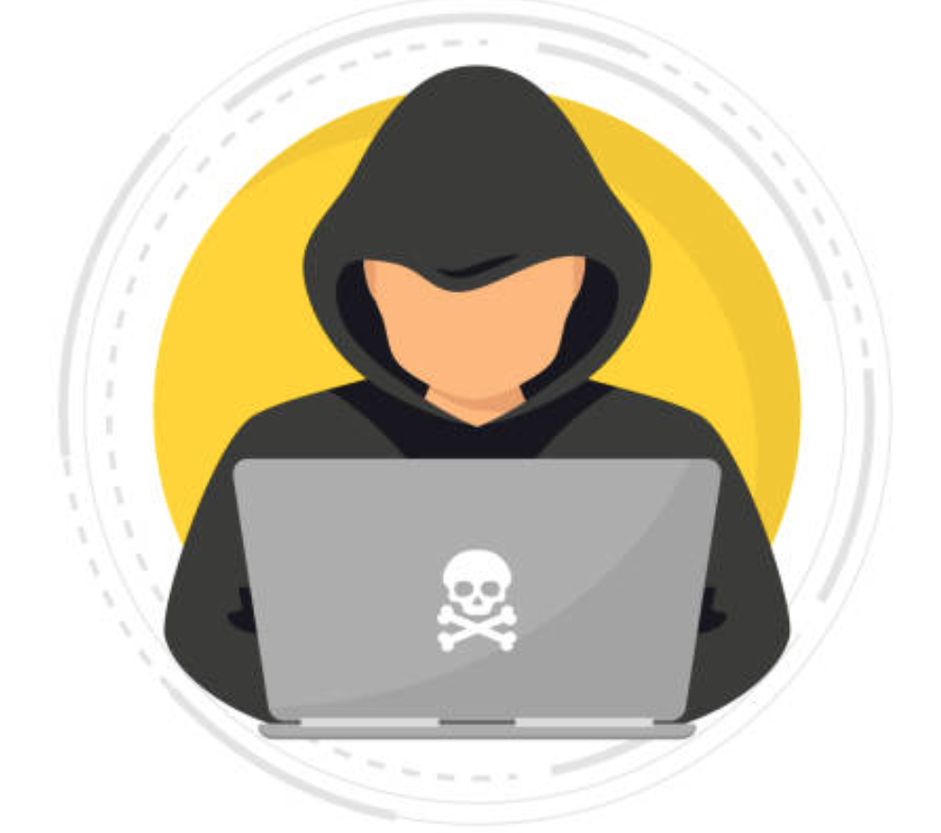
What is AI in Cybercrime?
Artificial Intelligence (AI): is technology that enables computers and machines to simulate human intelligence and problem-solving capabilities.
Criminals use AI to:
  Write highly convincing phishing emails and texts
  Clone voices to impersonate loved ones or officials
  Generate deepfake videos to deceive and manipulate
Source: https://www.ibm.com/topics/artificial-intelligence
Notes:
AI, or artificial intelligence, is when computers “learn” to do tasks that normally require human intelligence. While AI can be used to detect and block cyber threats, it’s also being used by criminals to create convincing fake messages, realistic phone calls, and even videos—making it much more challenging for everyone, including tech-savvy individuals, to tell real from fake.

Slide 11

How Cybercriminals Use AI Against You

Slide 12
1. Phishing Emails & Texts
Involves fake written content with human-like tone, puzzling the legitimacy of textual information
Well crafted information impersonating legitimate organizations and other people
For example, phishing emails with no grammatical and spelling errors

Slide 13
2. Deepfake Videos
Involves manipulating or creating entirely new video content using AI
Generates realistic facial expressions with desired/intended personality
For example: video showing your grandson crying and begging for money

Slide 14
3. Deepfake Audios
Involves creating realistic, synthetic voice recordings that mimic a person’s voice
Impersonate close relatives or friends through using an audiotape imitating the specific person’s voice
For example: a scam calls made by callers who impersonate close relatives and friends to lure you into sending them money through emotional manipulation

Slide 15
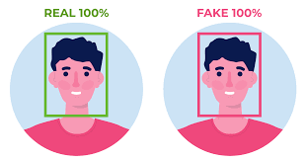
4. Deepfakes on Social Media
Involves creation of fake accounts, stories, or blogs to build a fake internet profile
Legitimates non-existent individuals or organizations
For example: an Instagram account for a broker with information on stock short-selling

Slide 16
5. Real-time or Live Deepfakes
Involves instant audiovisuals such as video calls
Generates more advanced real-time human cloning that converts face into someone else’s through live streaming
For example: receiving a video call from your granddaughter

Slide 17

6. Automated Scams
AI can send out thousands of scam attempts in seconds, targeting people who may be more trusting or less familiar with technology.

Slide 18
Common AI-Driven Senior Scams
Grandparent Scam
A caller or texter pretends to be your grandchild, claiming they’re in trouble and need money urgently. AI voice cloning makes the impersonation sound real.
Healthcare/Benefits Scam
Fraudsters pose as government or insurance officials, pressuring you to share personal information or make payments to “protect” benefits like Medicare.
Tech Support Scam
Scammers pretend to be from a well-known tech company, warning your device is infected. They push you to download malicious software or pay for fake repairs.
Prize/Lottery Scam
Victims are told they’ve won a contest or lottery, but must first pay “fees” or provide bank details to claim the prize.

Slide 19
How to Spot the Scam
Call to Action
a scammer needs you to do something
For example: Download a file, click a link, reply with information, or contact someone
Emotion or Urgency
often creates a sense of urgency to try to manipulate your emotions
For example: fear, curiosity, greed, or compassion
Malicious Intent
designed to cause harm
For example: steal data or deliver malicious software

Slide 20
Cyber Tips

Slide 21
Adopt a Zero-Trust Approach
Be wary of urgent calls to actions
Resist the urge to act immediately
Never send money to someone before consulting with other family members to confirm the situation
If you Don’t know the sender, think about other conversations you’ve heard from this person

Slide 22
If you’re Targeted
Document
Save messages and report detail
Seek Support
Talk to family or community center
Report
Canadian Anti-Fraud Centre

Slide 23


Slide 24
Question 3
True or False
Criminals are using AI tools like voice cloning and deepfakes to make scams more convincing.
True
False

Slide 25
Question 3
True or False
Criminals are using AI tools like voice cloning and deepfakes to make scams more convincing.
True
False

Slide 26
Question 3
True or False
Deepfake videos are always easy to spot because they look very different from real videos.
True
False

Slide 27
Question 3
True or False
Deepfake videos are always easy to spot because they look very different from real videos.
True
False

Slide 28
Question 3
True or False
Deepfake audios can make it sound like someone you know is asking for sensitive information.
True
False

Slide 29
Question 3
True or False
Deepfake audios can make it sound like someone you know is asking for sensitive information.
True
False

Slide 30
Question 3
True or False
Deepfakes on social media can spread misinformation quickly due to their convincing nature.
True
False

Slide 31
Question 3
True or False
Deepfakes on social media can spread misinformation quickly due to their convincing nature.
True
False

Slide 32
Question 3
True or False
Real-time deepfakes can be used during live video calls to impersonate someone in real-time.
True
False

Slide 33
Question 3
True or False
Real-time deepfakes can be used during live video calls to impersonate someone in real-time.
True
False

Slide 34

Questions??

Slide 35
Secondary Research - Sources in Notes

